Slide 1
OSI Security Architecture
ITU-T X.800, Security Architecture For OSI (‘91)
Defines a technique for defining security requirements, and characterizes the approaches to satisfy those requirements
Defines security attack, mechanism, and service
http://www.cse.wustl.edu/~jain/cse571-11/ftp/l_01ov.pdf
https://cgi.csc.liv.ac.uk/~alexei/COMP522_10/COMP522-SecurityArchitecture_07.pdf

Slide 2
OSI Security Architecture
Security attack: action that compromises the security of information owned by an organization (or person)
Passive: aims to learn or make use of system information only
Active: attempts to alter system resources/operation
https://cgi.csc.liv.ac.uk/~alexei/COMP522_10/COMP522-SecurityArchitecture_07.pdf

Slide 3
OSI Security Architecture
Security service is a service that ensures adequate security of the system or data transfer
Authentication
Access control
Data confidentiality
Data integrity
Non-repudiation
Availability
https://cgi.csc.liv.ac.uk/~alexei/COMP522_10/COMP522-SecurityArchitecture_07.pdf

Slide 4
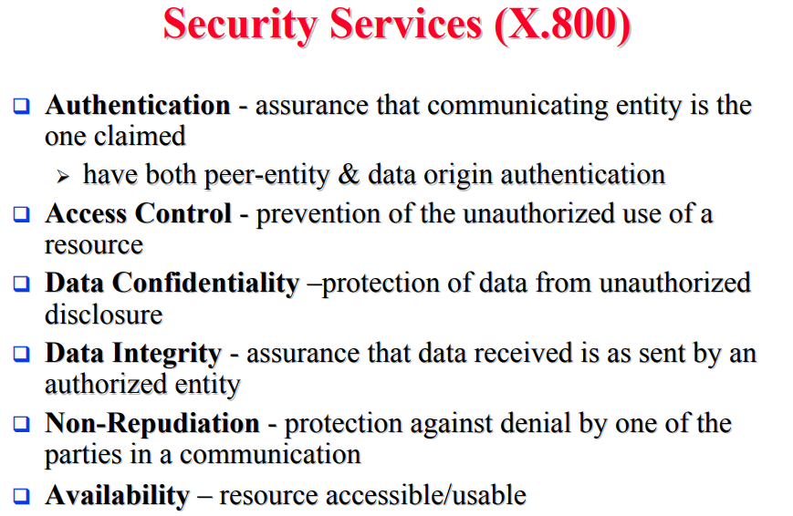
OSI Security Architecture
http://www.cse.wustl.edu/~jain/cse571-11/ftp/l_01ov.pdf

Slide 5
OSI Security Architecture
Security mechanism:
Feature designed to detect, prevent, or recover from a security attack
Cryptography underlies many of the mechanisms
http://www.cse.wustl.edu/~jain/cse571-11/ftp/l_01ov.pdf

Slide 6
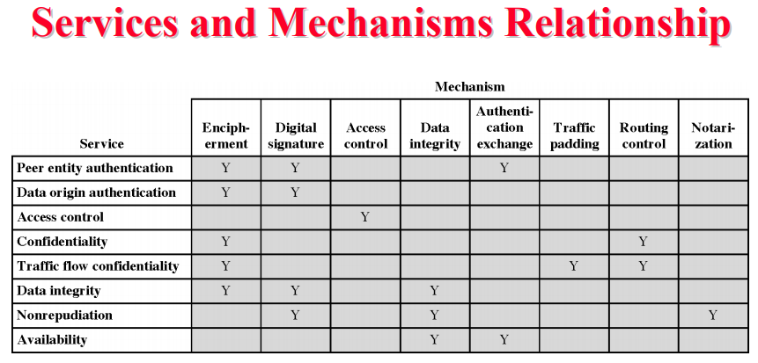
OSI Security Architecture
http://www.cse.wustl.edu/~jain/cse571-11/ftp/l_01ov.pdf

Slide 7
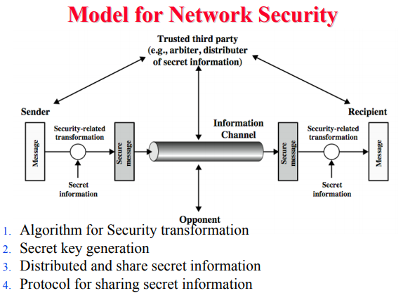
OSI Security Architecture
http://www.cse.wustl.edu/~jain/cse571-11/ftp/l_01ov.pdf

Slide 8
OSI Security Architecture
ITU-T X.800, Security Architecture For OSI is dated from 1991

